Slide 1
AIREI 2012 ENERGY INSTITUTE
Stephen Manydeeds
Division Chief
U.S. Department of the Interior
Assistant Secretary - Indian Affairs
Office of Indian Energy and Economic Development
Division of Energy and Mineral Development
August 16, 2012

Slide 2
Mission
Provide the best possible technical and economic advice and services in assisting Indian mineral owners to achieve economic self-sufficiency by creating sustainable economies through the environmentally sound development of their energy and mineral resources.

Slide 3
DEMD Responsibilities
Provide technical, engineering and economic advice to Indian landowners seeking to manage and develop their energy and mineral resources
Generate effective energy and mineral development strategies
Assist Indian mineral owners during energy and mineral negotiations
Provide technical data and interpretations for exploration and development of resources
Manage and maintain existing Indian energy and mineral data
Division Chief
Stephen Manydeeds
(720) 407-0600
stephen.manydeeds@bia.gov
Ideal impact:
Jobs and Income
Notes:
Primary goal: provide the best possible geotechnical, engineering, and economic advice to Indian landowners seeking to manage and develop their energy and mineral trust resources

Slide 4
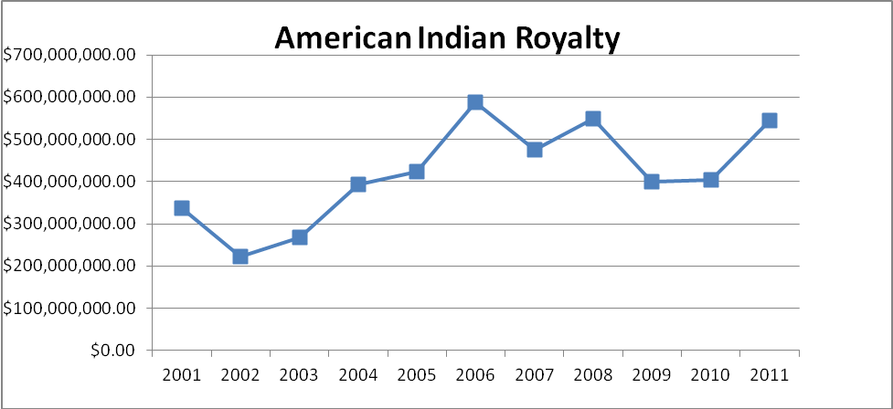
Royalty Income from Energy and Mineral Production on Indian Lands
¹Data from Office of Natural Resources Revenue (ONRR) website
In 2011 alone (most recent ONRR data available), energy and mineral resources generated over $545 million in royalty revenue paid to Indian mineral owners.
Nationwide Indian average of 16.88% of the gross revenues, far in excess of the nationwide federal national average of 11.29% of the gross revenue (Source: Office of Natural Resources Revenue (ONRR) website www.onrr.gov/ONRRWebStats)

Slide 5
Energy and Minerals Impact
on Indian Trust Lands For 2010
Commodity | Value ($ millions) | % of Value | Estimated Economic Impact ($ millions) | % of Economic Impact | Estimated Jobs Impact (jobs) | % of Estimated Jobs Impact
Energy | 2,483 | 68 | 10,473 | 72 | 89,363 | 65
Minerals | 635 | 17 | 1,836 | 13 | 31,580 | 23
SUB-TOTAL | 3,118 | 85 | 12,309 | 85 | 120,943 | 88
Irrigation | 471 | 13 | 1,330 | 9 | 12,448 | 9
Timber | 41 | 1 | 714 | 5 | 2,637 | 2
Grazing | 54 | 1 | 95 | .7 | 733 | .5
Total | 3,683 |  | 14,449 |  | 136,761
Source: Table from The Department of the Interior’s Economic Contributions – June 21, 2011

Slide 6
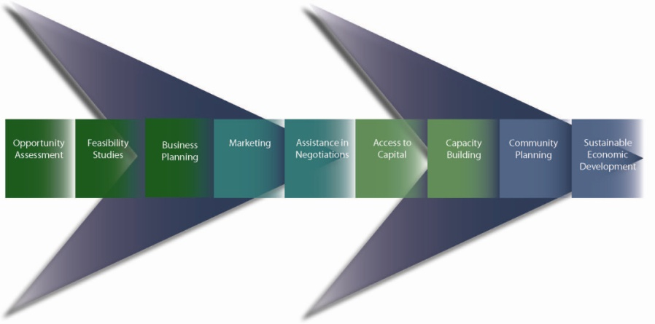
Many Options… Define Your Problem
First: Clearly identify your problem that you want to solve
Second: Analyze your options to find the best fit to solve those problems - then focus

Slide 7
How Renewable Energy Can Impact Self-Sufficiency
Scale | Community | Industrial | Utility
Purpose | Small system supplying energy to a single building/home | Medium scale base load power plant supplying energy to several local facilities | Large wind or solar power plant, grid connected, exporting energy to distant users
Income Generation | Offset energy costs | Offset energy costs, lease payments, and energy sales | Lease payments and/or energy sales
Job Creation | Construction and installation jobs | Up to 20-30 full time jobs per power plant | Temporary construction jobs, limited long term jobs
Added Value Potential |  | Attract new business to renewable powered eco-park

Slide 8
What’s Driving Utility Scale Projects?
Economic Driver | Details | Issues
Tax Incentives | Investment Tax Credit 1603 Grant in Lieu of Investment Tax Credit Production Tax Credit | Credits are expiring Need tax appetite Most project not feasible without current incentives
Renewable Portfolio Standards | 29 states have RPS 8 states have goals | Not every state has standards State’s want generation from within state Standards do not necessarily apply to every utility company. Wheeling fees apply if looking to sell across state borders

Slide 9
What DEMD is seeing in Indian Country with Utility Scale Projects
Most success with Tribe as Lessee
Issues limiting success with Tribe as Owner
Access to tax incentives
PPA issues – competing with low cost fossil fuels
Lack of available transmission capacity
High upfront costs
Lack of proper business setting for attracting partners

Slide 10
Production Tax Credit Impact on Wind

Slide 11
Industrial Scale Power
Base load renewable power
Reliable
Attractive to industry
Industry creates jobs!
Base load renewable resources
Biomass (wood and municipal solid waste)
Geothermal
Hydroelectric

Slide 12
Industrial Scale Projects An easier path for Tribal Ownership
Success Limiting Issue | Utility Scale | Industrial Scale
Tax Incentives | Strongly dependant | Less dependant
PPA | Competing with whole sale rates (cheap fossil fuels) | You are competing with local rates, that your paying
Transmission | Strongly dependant Difficult to connect large intermittent loads | Somewhat dependant Easier to connect small base load power Can connect directly to local facilities
Upfront costs | $100 million + | $10-20 million
Business setting | Strongly dependant | Strongly dependant

Slide 13
Utility Scale Project Comparison
25 MW – Tribally owned – No Taxes
Type | Wind | Solar | Waste-to-Energy (combustion)
Acres | 625 | 250 | 10
Break Even Cost of Energy | $0.14/kWh | $0.48/kWh | $0.05/kWh
Rate of Return | 4% @ $0.12/kWh | 13.7% @ $0.50/kWh | 32% @ $0.08/kWh
Electricity Production | 61,300 MWh 28% capacity factor | 48,000 MWh 22% capacity factor | 197,000 MWh 90% capacity factor
Homes Powered | ~ 6,000 homes | ~ 4,800 homes | ~ 19,700 homes
NEPA | EIS | EIS | EA

Slide 14
Industrial Scale WTE Project Economics
Type | 1.5 MW Waste-to-Energy (pyrolysis or gasification)
Acres | 5
Rate of Return | 15% @ $0.04/kWh
Electricity Production | 12,000 MWh 90% capacity factor
Homes Powered | ~ 1,000 homes
Revenue Streams | Electricity sales Tipping fees (you get paid for your fuel!) Recyclables (aluminum, plastics, etc.) Crude oil Ash?

Slide 15
Industrial Scale Job Opportunities
Oneida Waste to Energy Power Plant
30 full time jobs
Electricity supporting local industry = local jobs!
Fond du Lac Combined Heat and Power
Supplying energy to pellet manufacturing
Up to 75 jobs created!
Supporting business – Pellet stove retail and installation

Slide 16
Up to 85% of income can stay on the reservation …
if energy needs are generated locally

Slide 17
Community Scale Development

Slide 18
Compressed Earth Block (CEB) Housing: Goals of project
Self- Help Tribal Housing Solution
Utilize local materials and local labor force
Keep maximum amount of funds (HUD/HIP Grants) in the Reservation Economy (Economic Development)
Provide Alternative to Status Quo
No more trailer and pre-fab housing
Create Jobs that will last (not a jobs program a CAREER program)
Sustainable, scalable business model that can be replicated in other Native Communities
Increase home owner disposable income (poverty reduction)

Slide 19
Goals Completed to Date
Self-Help Solution: Two Tribal Businesses Created
CEB manufacturing plant
CEB Home Construction (Good Earth Lodges)
Funds kept on the Reservation
Trailer/pre-fab status quo only kept 15% of funds in Reservation economy
CEB project has proven to keep 53% of funding in the Reservation economy
20 careers have been created
Business Model is fully replicable and can be implemented with other Tribes
CEB homes reduce home owner utility expense by 80%

Slide 20
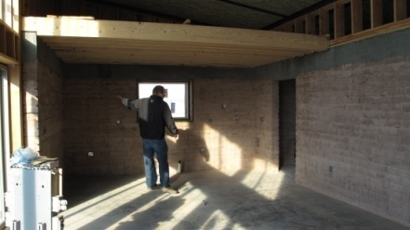
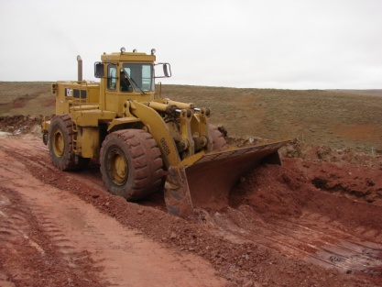
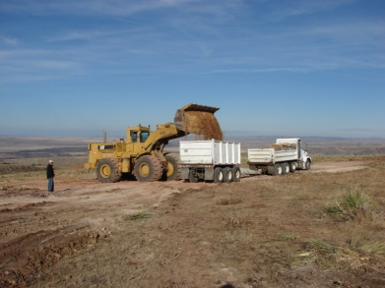
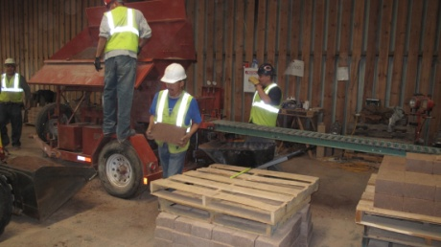
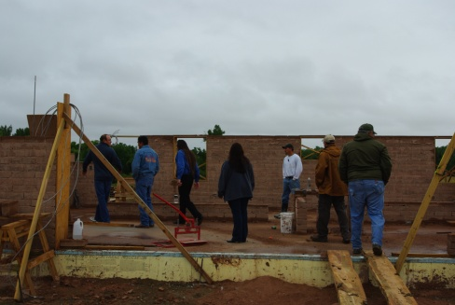
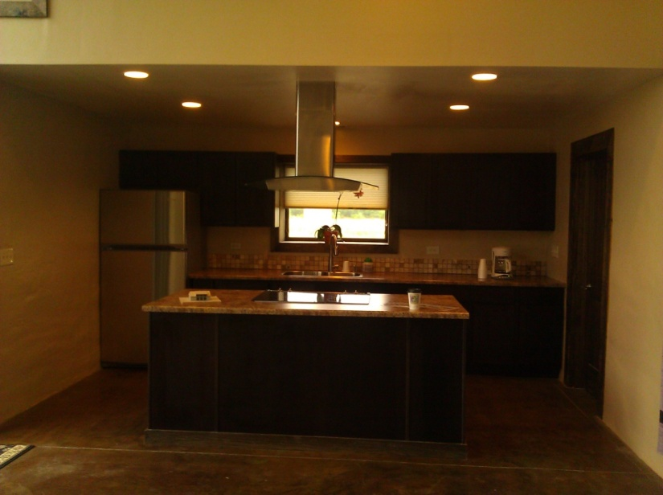
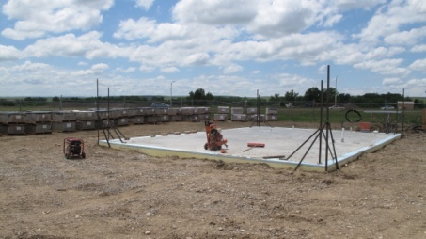
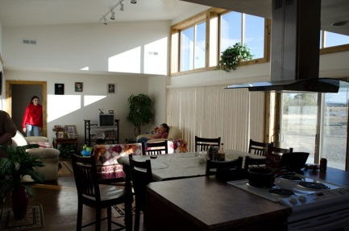
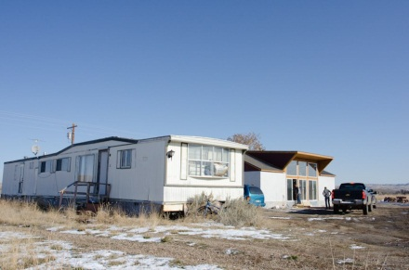
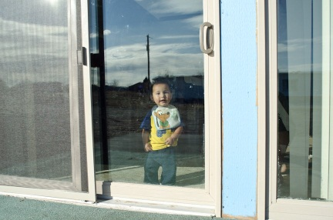
CROW CEB Project
Clay Mining
Interior framing/finish
Clay Transport
CEB Production
CEB wall construction
Final (Interior)
Construction Begins
Final (Interior)

Slide 21
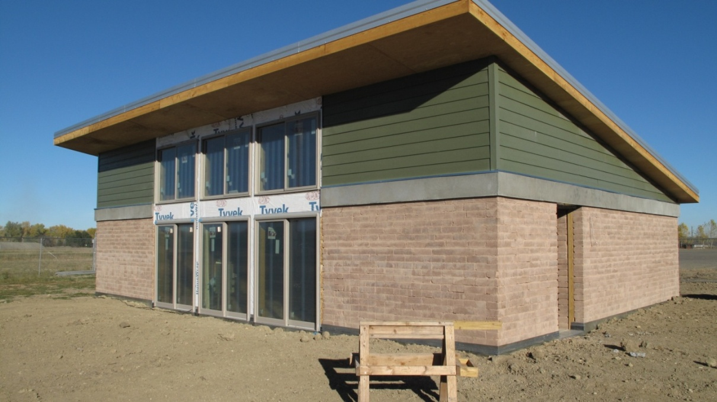
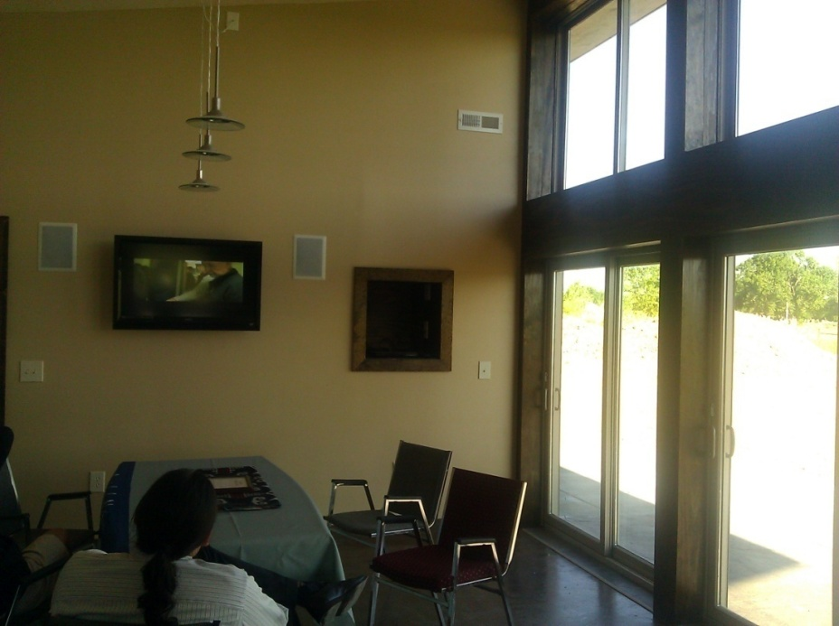
Community Scale
Crow Nation – Compressed Earth Block Housing Project
http://goodearthlodges.crowtribe.com

Slide 22
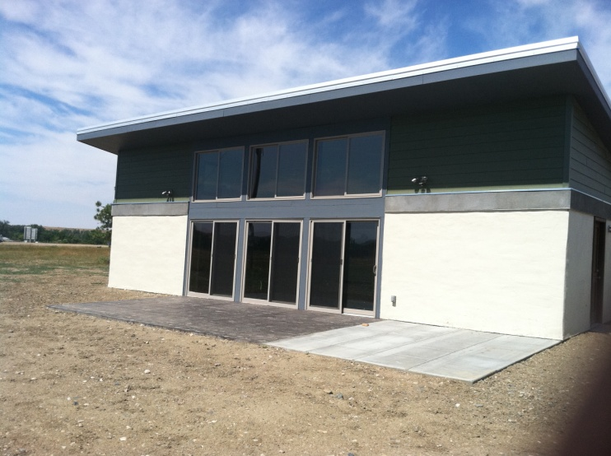
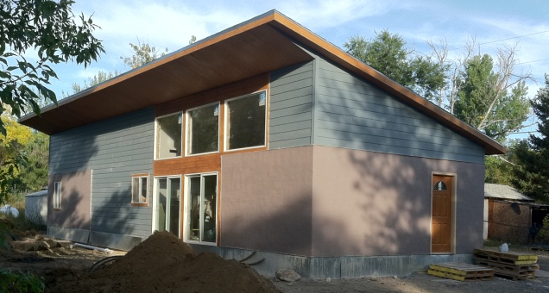
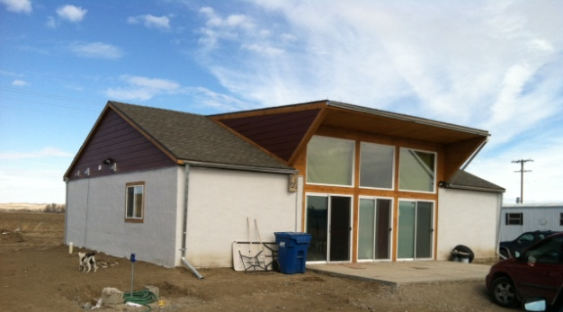
Phase 1: 6 CEB Homes
Construction Status: Complete In 2011
Occupancy Status: Occupied

Slide 23
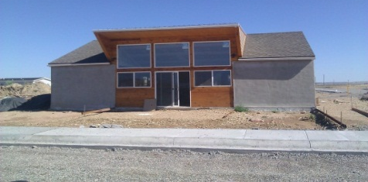
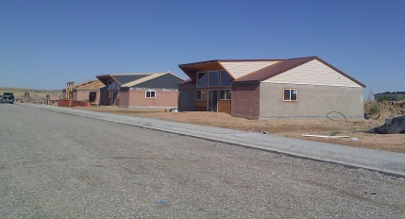
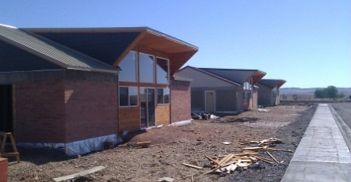
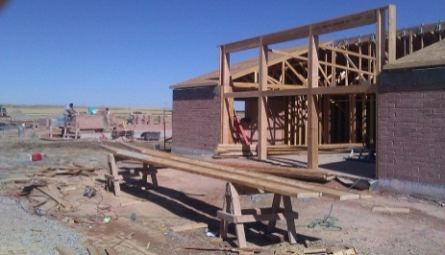
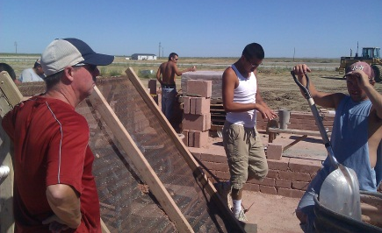
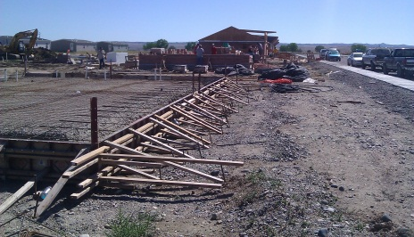
Phase 2: Crow Agency Subdivision 7 CEB Homes as of Mid-July, 2012
Crow Agency Subdivision Home #1 | Crow Agency Subdivision Home #2 | Crow Agency Subdivision Home #3
Construction Status: Completed dry-in. Interior finish has begun. | Construction Status: Completed dry-in. Interior finish is now beginning. (homes 3&4 in background). | Construction Status: Exterior stucco to be applied and then interior finish will begin. (homes 1&2 in background)
Crow Agency Subdivision Home #4 | Crow Agency Subdivision Home #5 | Crow Agency Subdivision Home #6
Construction Status: 2 weeks from complete dry-in. | Construction Status: CEB wall construction underway. | Construction Status: Foundation ready to be poured.
Crow Agency Subdivision Home #7 Construction Status: Siting complete

Slide 24
Geothermal Heat Pumps
Use the Earth’s constant underground temperature
Provide heating and cooling to buildings
Low maintenance
Energy Efficient

Slide 25
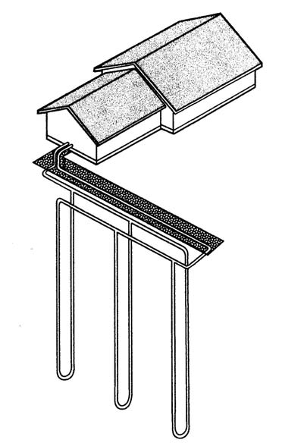
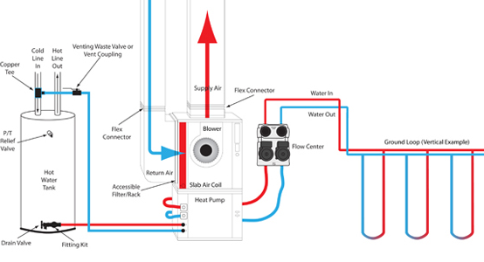
Geothermal Heat Pumps
Vertical Loop Systems
200-300 ft deep
150 – 300 ft² area per system ton
Area will be usable after installation

Slide 26
The Cost of Geothermal Heat Pumps
The average cost of a 2.5 to 3 ton unit is $5,000 with an additional cost of $13,500 for installation. The payback for geothermal heat pumps is between 5 to 7 years in this area.
Geothermal heat pumps are durable and require little maintenance. They have fewer mechanical components than other systems, and most of those components are underground, sheltered from the weather. The underground piping used in the system is often guaranteed to last 25 to 50 years and is virtually worry-free. The components inside the house are small and easily accessible for maintenance. Warm and cool air are distributed through ductwork, just as in a regular forced-air system.

Slide 27
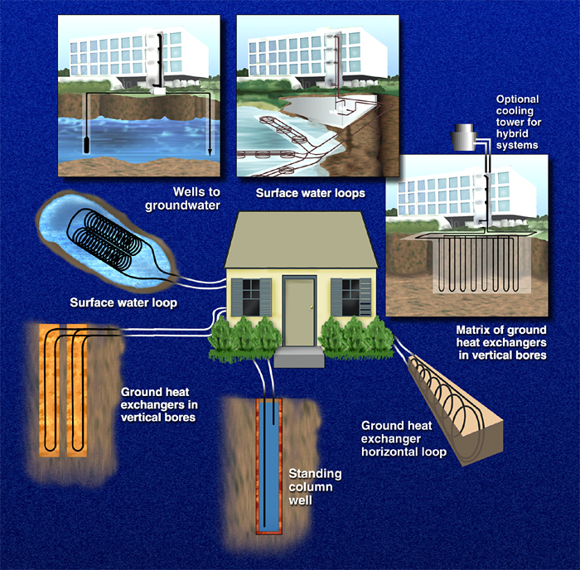
The Cost of Geothermal Heat Pumps

Slide 28
Ground Source Heat Pump Website Sources
Geo-Heat Center: http://geoheat.oit.edu/
GeoExchange: http://www.geoexchange.org/
Geothermal Education Office: http://geothermal.marin.org/
International Ground Source Heat Pump Association IGSHPA: http://www.igshpa.okstate.edu/directory/directory.asp
Ground Source Heat Pump Design – Keep It Simple & Solid: http://www.geokiss.com/res-design.htm
U.S. DOE Energy Efficiency and Renewable Energy – Rebates, Tax Credits and Financing: http://www.energysavers.gov/financial/70010.html
Notes:
Some companies offer all or a combination of the following services. Design of a system may include not only the HVAC configuration and size, but also require loop design (which can be vertical, or horizontal). Another section is the Drilling of vertical boreholes and loop installation. Next, is the installation of the home heat pump which needs to be finished by tying into the outdoor field loop. Some companies have acquired accreditation for designing, drilling installation and heat pump installation offered by the international ground source heat pump association.

Slide 29
Citizen Potawatomi Nation
GSHP systems in casino, homes and golf course
Installation as a business
*Source: Citizen Potawatomi Nation

